Slide 1







Emotion
Classifier
Howdy !? How ya feeling today ?

Slide 2





Our Team Members
Abdulrahman
Ayman Farid
Abdulrahman
Mohammad
Abdelrahman
Abdulllah Mohammad
Zayed
Leader
Abdullah Amin
Mohammad Yasser
Mohammad Tamer Atef

Slide 3


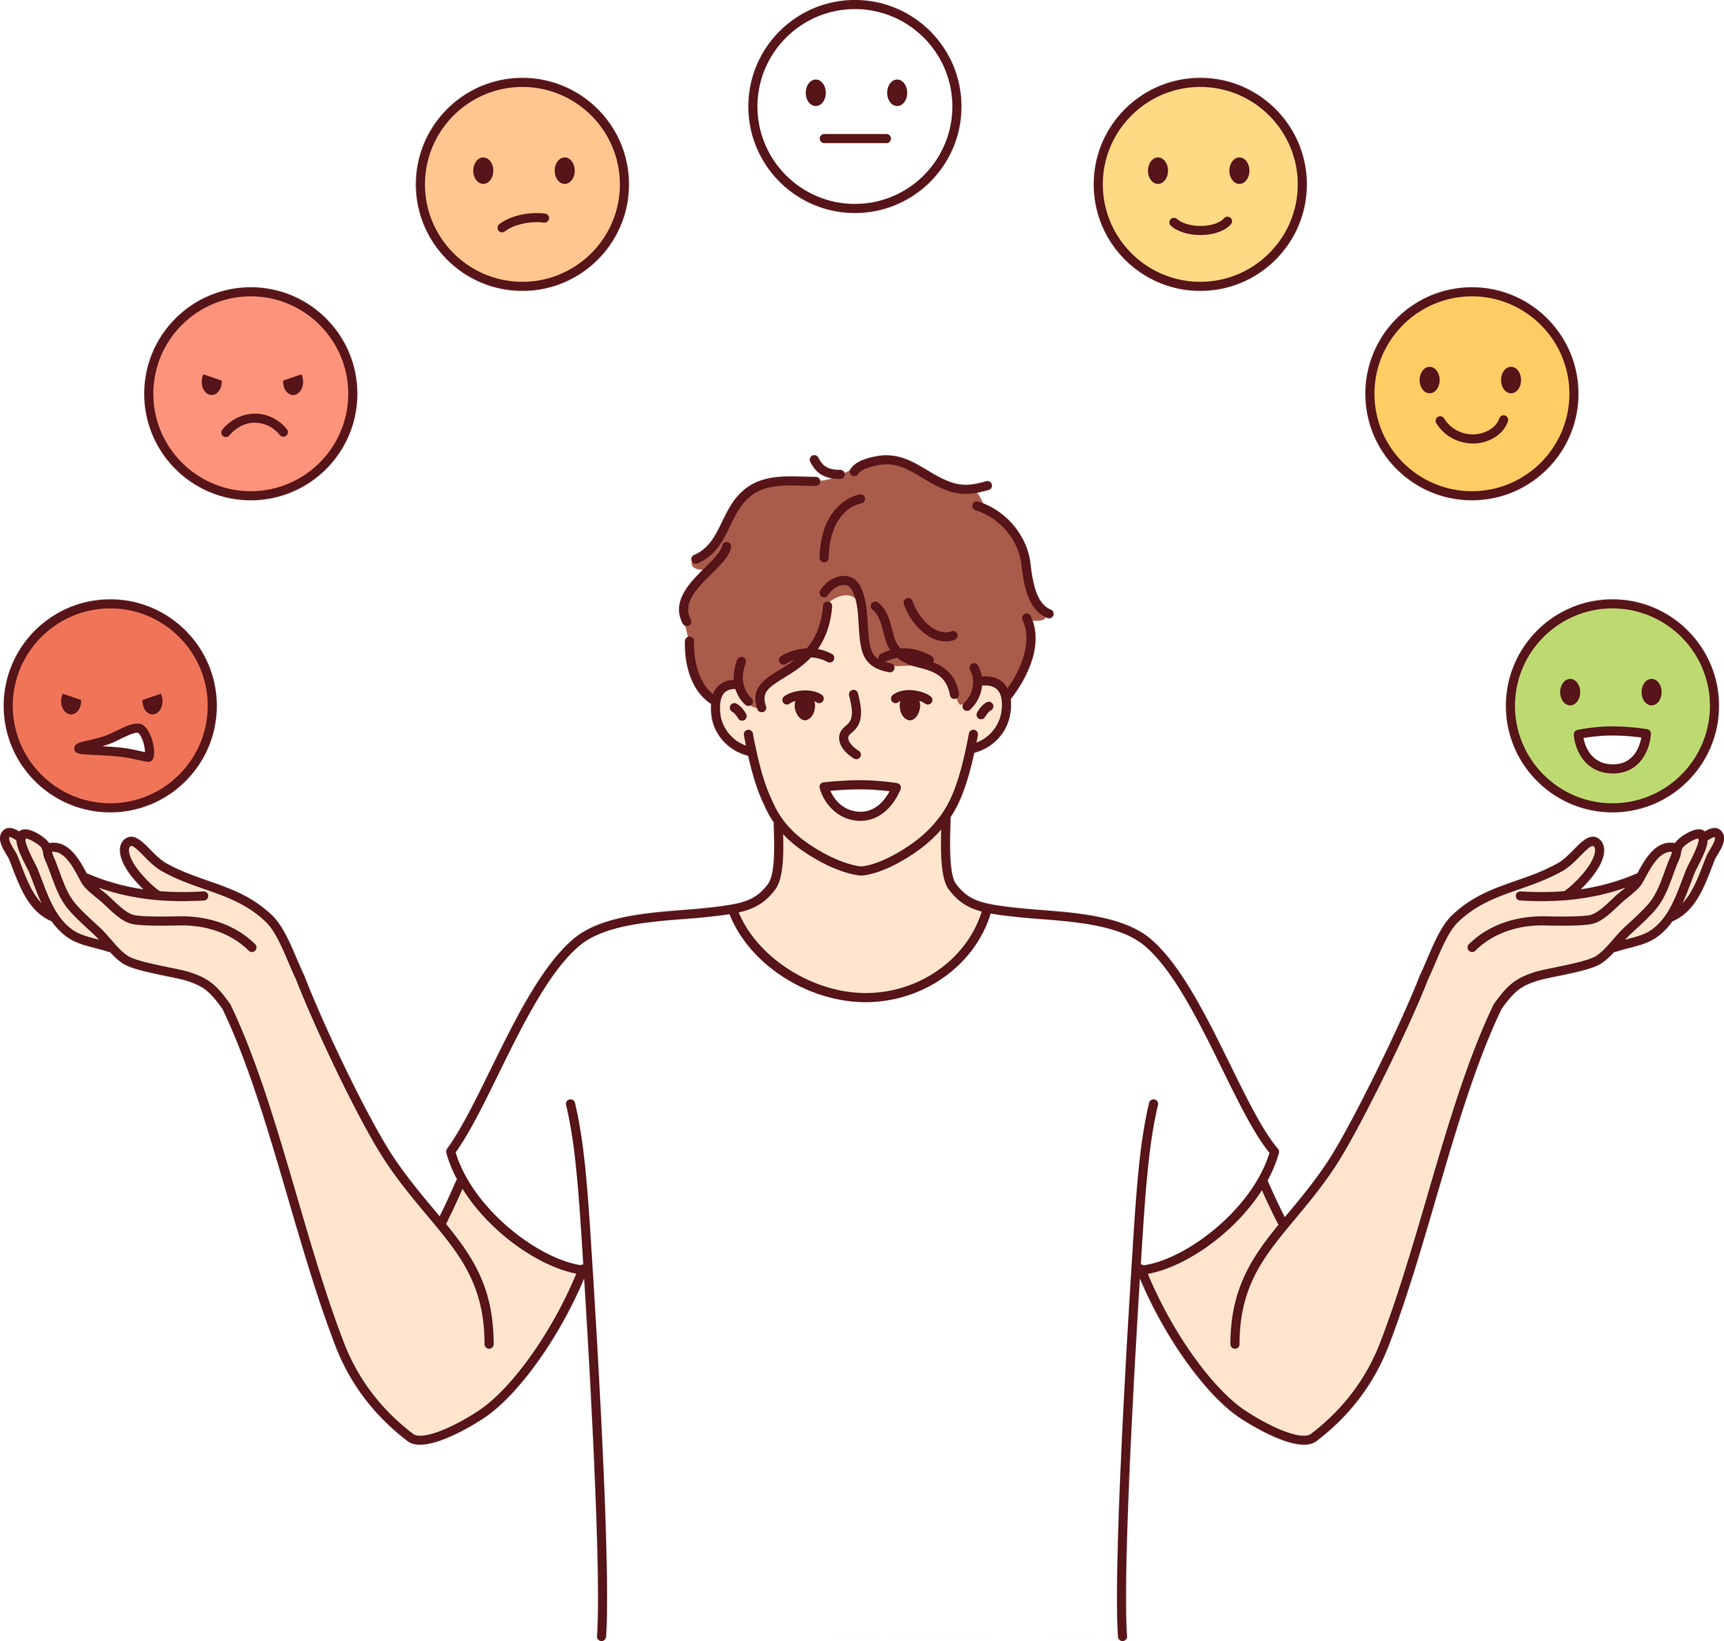


Problem
Understanding emotions is crucial in various domains like mental health, customer service, and entertainment.
Current systems often focus on limited modalities, lacking versatility.

Slide 4


numpy
pandas
os
matplotlib
seaborn
tensorflow
keras
cv2
Libraries

Slide 5


Dataset
FER-2013 Dataset
7 Classes
+15K photo
(anger) (sadness)(happiness)(fear)(disgust)(neutral)(surprise)

Slide 6

Data Augmentation
Transformations:
width_shift_range and height_shift_range: Randomly shift the image horizontally or vertically.
horizontal_flip: Randomly flip the image.
rescale: Normalize pixel values to the range [0, 1].
validation_split: Reserves a portion of images for validation.
Tools:
ImageDataGenerator from Keras applies these transformations.

Slide 7





Data Preparation
Logic:
train_generator :
Reads images from train_dir.
Applies augmentation defined in train_datagen.
Converts images to grayscale (color_mode='grayscale').
Sets class_mode='categorical' to handle multiple emotion classes.
validation_generator:
Reads images from test_dir.
Uses transformations defined in validation_datagen.
Reserves images for validation.

Slide 8

Model Architecture
Convolutional Layers:
Use Conv2D with increasing filters (64, 128, 256) to extract spatial features.
activation='relu': Applies the ReLU activation function.
Pooling Layers:
MaxPool2D: Downsamples feature maps to reduce dimensionality.
Batch Normalization:
Normalizes layer outputs to stabilize training.
Dropout:
Prevents overfitting by randomly dropping neurons during training.
Fully Connected Layers:
Flatten the feature maps and connect to dense layers.
Use softmax activation for the output layer to predict emotion probabilities.

Slide 9
Training Parameters
epochs : 60
batch_size = 64 per imagae

Slide 10

Output !

Slide 11
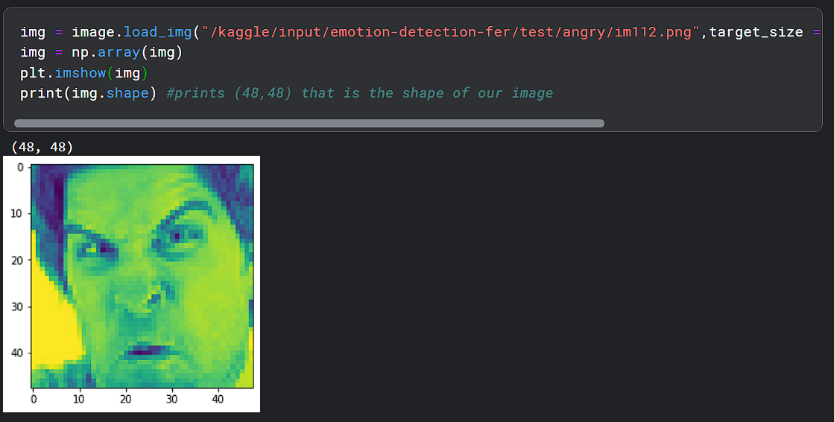

Slide 12
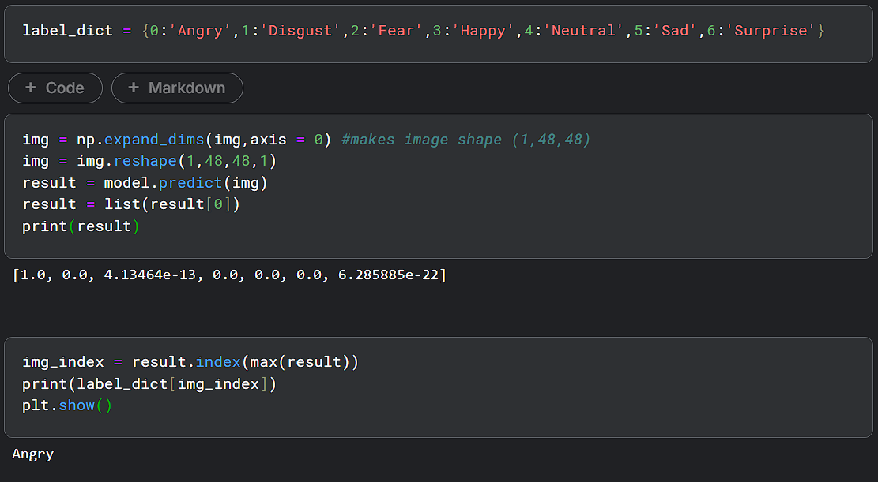

Slide 13
Summary
the project focuses on building a CNN-based emotion classifier by :
1-Load and augment image data.
2-Define CNN architectures with varying complexity.
3 -Train the model on FER dataset images.
4 -Visualize training performance.
5-Test the model on individual images.
6 -Evaluate final performance metrics.

Slide 14
Thank you !

